Slide 1
Applications of Quantum Mechanics in Electronics under Research
Jacob Knaup
PHY252

Slide 2
Concepts

Slide 3

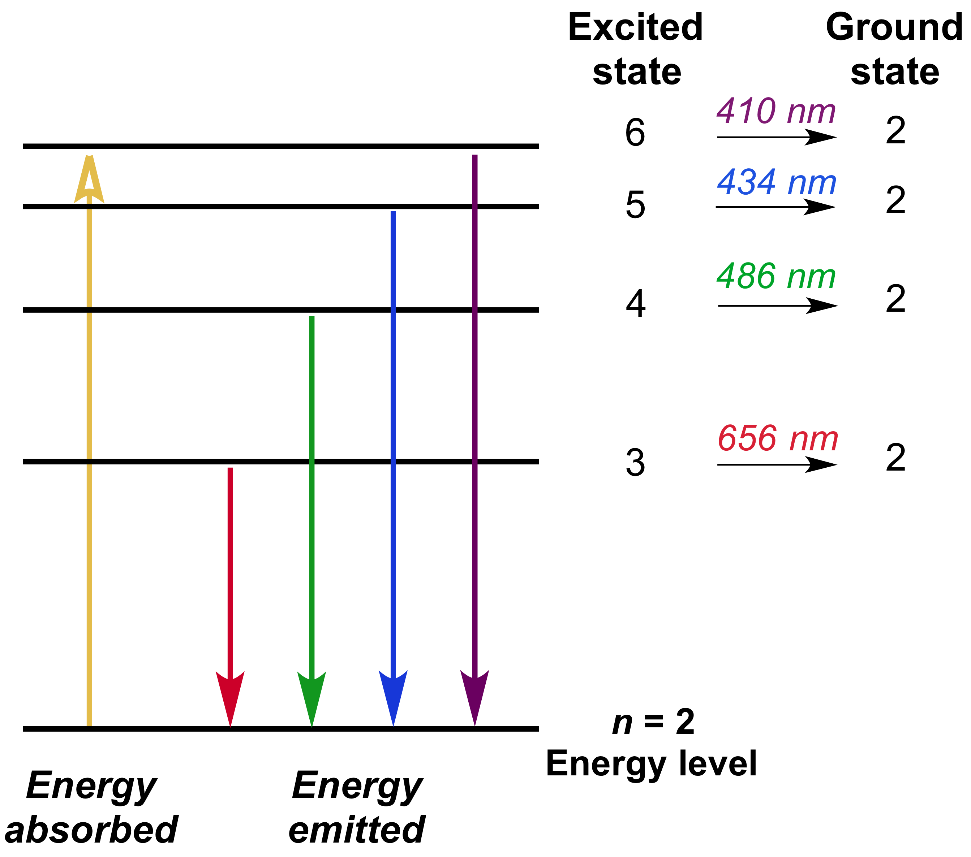
Atomic Energy Levels
Electrons in an atom jump between energy levels
A photon is absorbed when jumping to a higher energy level
A photon is emitted when dropping to a lower energy level
The photon’s energy must be equal to the difference in energy levels

Slide 4

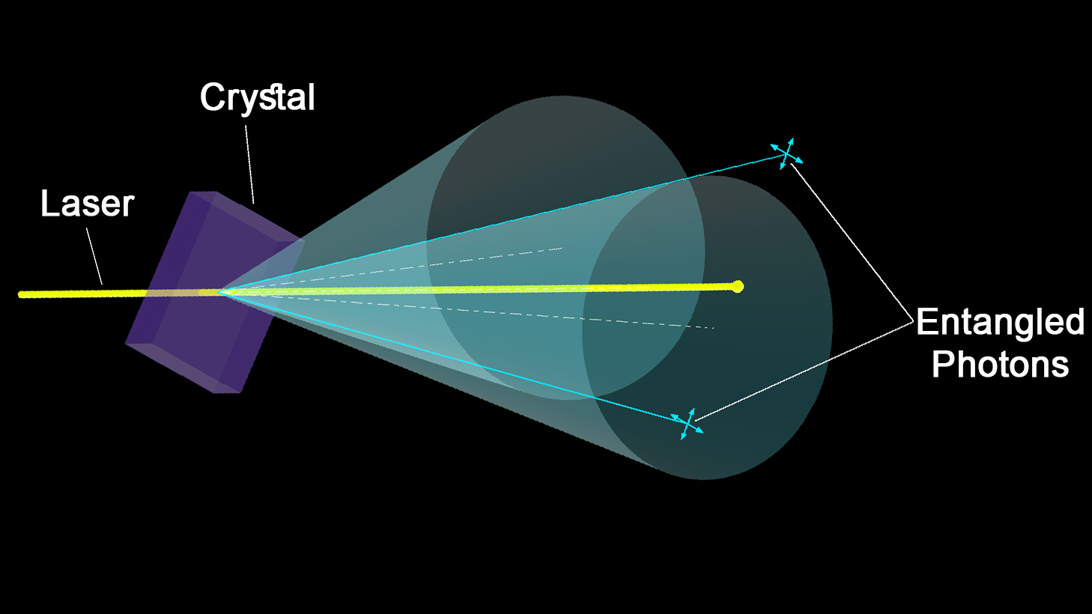
Quantum Entanglement
Particles on opposite sides of the universe can be linked so as to share information instantaneously
Cascade Transition
Conservation of angular momentum: when two photons are emitted from , their spins must be opposite
Parametric Downconversion
Splitting beam of high energy photons (laser) into two beams of lower energy photons

Slide 5
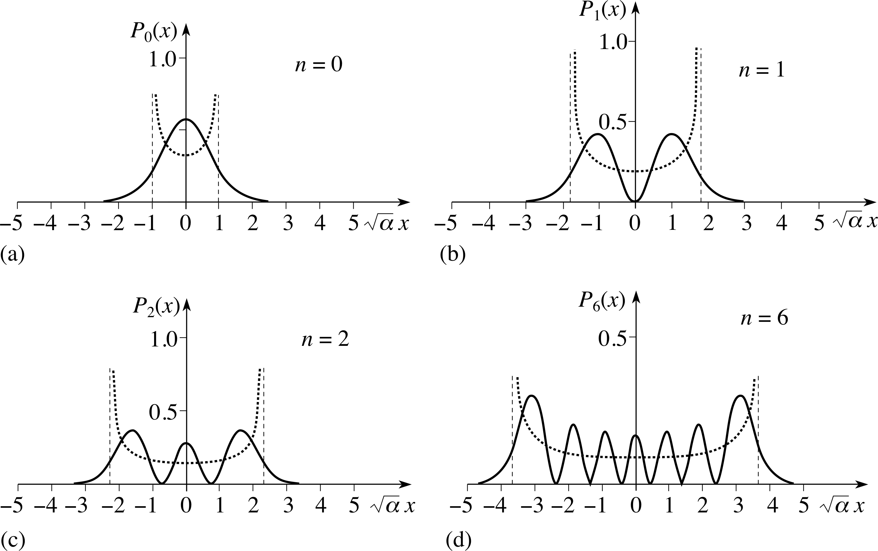
Quantum Tunneling
Position not deterministic
Probability distribution

Slide 6
Debate

Slide 7
Albert Einstein
“Can Quantum-Mechanical Description of Physical Reality be Considered Complete?” 1935
Scoffed at quantum theory
Too “spooky” to be real

Slide 8
John Stuart Bell
1964
Proved Quantum theory complete and workable
Bell’s Theorem:

Slide 9
Atomic Clocks
High accuracy and consistency over time

Slide 10
Usage of clocks
Synchronize electronics
Especially in wireless communications
Examples
Telecommunications
GPS
Surveying
Computers

Slide 11
Existing/Old Technologies
Clocks rely on regular oscillations
Small amount of drift can cause wireless devices to broadcast in different frequencies or lose synchronization between devices
Pendulum—moves back and forth with simple harmonic motion (ideally)
In reality there is small amount of frictional and viscous damping
Quartz crystal—piezoelectric device, produces electro-mechanical vibrations
Sensitive to temperature and humidity

Slide 12

New Technology: Atomic Clocks
Monitor radiation frequency needed to make electrons jump between energy levels
Laser light of specific wavelength needed for electrons to switch energy levels
More atoms increase precision by factor of $\sqrt{n}$
Current research seeks to use entanglement to innately synchronize clocks remotely

Slide 13
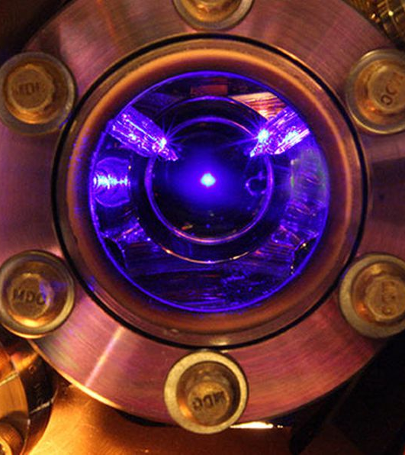
Real-world Atomic Clocks
Quantum-logic clock at U.S. National Institute of Standards and Technology (NIST)
Accurate to within a second for 3.7 billion years
Strontium Clock at NIST
Accurate to within a second for 5 billion years

Slide 14
Quantum Key Distribution
A more secure means of distributing keys for encryption

Slide 15
Cryptography
Sender has plain text message and encryption key
These are used to create encoded message
Encoded message must be sent to recipient along with the key

Slide 16
Insecurities
Message can be decoded without the key using brute-force methods
Solution: use a longer key, ideally one as long as the message itself
Then there is no way to check if the decoded message is valid without the key
Key can be intercepted during communication
Solution: Quantum Key Distribution (QKD)

Slide 17
Quantum Key Distribution (QKD)
Key is sent as randomly polarized photons over fiber optic cables
Polarized: Oscillates in only one plane
Recipient uses polarized filters to read the key
Reading the entangled photons will change their states, making eavesdropping detectable

Slide 18
Real-world QKD
Bank transfers in Austria (2004)
Voting system in Switzerland (2007)
Secure networks at Toshiba
Entangled photons cannot be communicated over long distances

Slide 19
Quantum Computers
Super-fast computers

Slide 20
New Technology
Traditional computers represent information as series of bits (1s and 0s)
Quantum computers use qubits
Exist in superposition of 1 & 0 until measured
Able to tunnel to lower energy levels, allowing them to theoretically reach solution faster

Slide 21
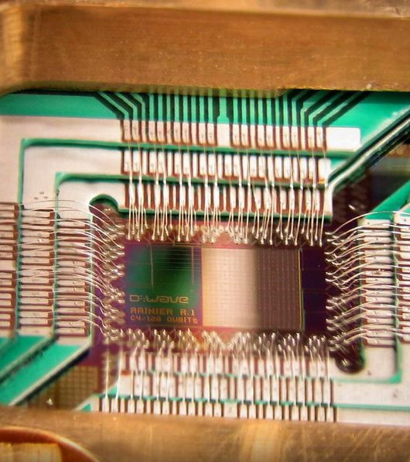
Real-World Quantum Computers
D-Wave Two developed by D-Wave Systems in 2012 ($10 million)
However, controversy over whether true quantum computer
Inconsistent results when measuring improved performance
Some but not all qubits entangled

Slide 22
References
Cho, Adrian. 2014. “Quantum or Not, Controversial Computer Yields No Speedup.” Science 344 (6190): 1330–31. https://doi.org/10.1126/science.344.6190.1330.
Greenemeier, Larry. n.d. “Election Fix? Switzerland Tests Quantum Cryptography.” Scientific American. Accessed April 24, 2018. https://www.scientificamerican.com/article/swiss-test-quantum-cryptography/.
Hernandez, Paul. 2015. “Getting Better All the Time: JILA Strontium Atomic Clock Sets New Records.” Text. NIST. April 21, 2015. https://www.nist.gov/news-events/news/2015/04/getting-better-all-time-jila-strontium-atomic-clock-sets-new-records.
Jenner, Nicola. n.d. “Five Practical Uses for ‘Spooky’ Quantum Mechanics.” Smithsonian. Accessed April 22, 2018. https://www.smithsonianmag.com/science-nature/five-practical-uses-spooky-quantum-mechanics-180953494/.
Knight, Will. n.d. “Entangled Photons Secure Money Transfer.” New Scientist. Accessed April 24, 2018. https://www.newscientist.com/article/dn4914-entangled-photons-secure-money-transfer/.
Ma, Xiao-Song, Thomas Herbst, Thomas Scheidl, Daqing Wang, Sebastian Kropatschek, William Naylor, Bernhard Wittmann, et al. 2012. “Quantum Teleportation over 143 Kilometres Using Active Feed-Forward.” Nature 489 (7415): 269–73. https://doi.org/10.1038/nature11472.
Woodford, Chris. n.d. “How Quartz Watches and Clocks Work.” Explain That Stuff. Accessed April 24, 2018. http://www.explainthatstuff.com/quartzclockwatch.html.

